Slide 1
3.2 Improving decoupling processes status
8 October 2026
MESC

Slide 2
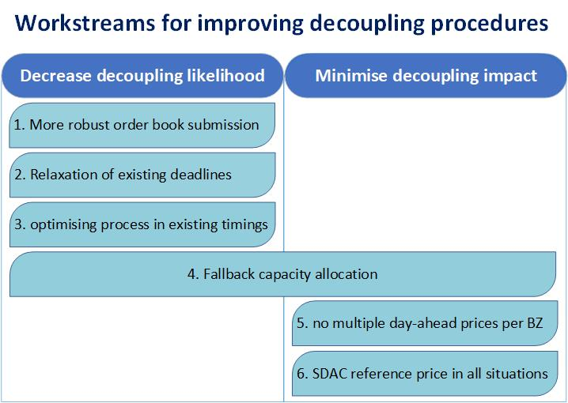
Discussed topics

Slide 3
Topics
Topic
WS 3: Optimise existing SDAC and SIDC timings and procedures Optimise existing timings
WS 1: Minimise the likelihood of partial decoupling due to failed submission of order books in time Daily pre-order book submission test More robust local trading system (LTS)
WS 2: Relax existing deadlines Relaxing the 15:30 deadline
WS 4: Fallback capacity allocation Continuous SIDC as the fallback solution for DA capacity allocation WS 6: Ensuring a single SDAC reference price in every bidding zone in all situations - Develop a single SDAC price solution for the case of full decoupling
WS 5: Preventing multiple SDAC prices in a bidding zone

Slide 4
WS 1: Minimise the likelihood of partial decoupling due to failed submission of order books in time
Daily pre-order book submission test
New daily operational process for orderbook early pre-check and validation
Phase approach with implementation
  2026 – voluntary implementation (some of the NEMOs already implemented it)
  2027 – mandatory implementation for all NEMOs
Status (June)

Slide 5
WS1: Minimise the likelihood of partial decoupling due to failed submission of order books in time
More robust Local trading system
NEMOs presented 3-pillar framework for architecture harmonization and resilience
The proposal covers a range of solutions and good practices
NEMOs are actively working on introducing regular KPI monitoring for each solution type within 3-pillar framework.
ACER asked NEMOs to prepare Joint NEMO’s guidelines on LTS IT robustness which will be obligation of all NEMOs in operation and report to ACER the KPIs which will be used for monitoring

Slide 6
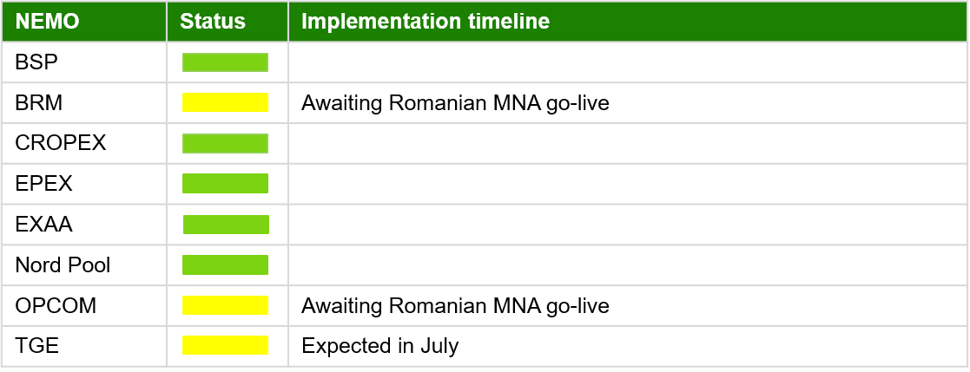
WS 3 and 5: Optimise existing timings and procedures and ensuring a single SDAC price in decoupling
WS 3: Optimise existing SDAC and SIDC timings and procedures
NEMOs prepared the first 6-month report on the improvements of SDAC timings and procedures
ACER identified several issues in current procedures and will propose improvement measures (incident on 17 May 2026)
  WS 5: Preventing multiple SDAC prices in a bidding zone
  Ensuring a single SDAC price in decoupling without fallback capacity allocation
  Volume Allocation mechanism in CORE is implemented by several NEMOs already (status in June)

Slide 7
WS 2, 4 and 6
The work on remaining workstreams is closely related:
  Shifting cross-border nomination deadline from 15:30 to 16:00
  Replacing shadow auctions with SIDC continuous trading as fallback mechanism
  Ensuring single SDAC price in case of application of fallback mechanism in all bidding zones
The current MCSC proposal is not yet fully aligned with ACER’s objectives, which are:
    Improving fallback allocation mechanism
    Harmonising fallback mechanism
Next workshop on mitigation measures and improving the decoupling processes
  14 October 2026

